Slide 1
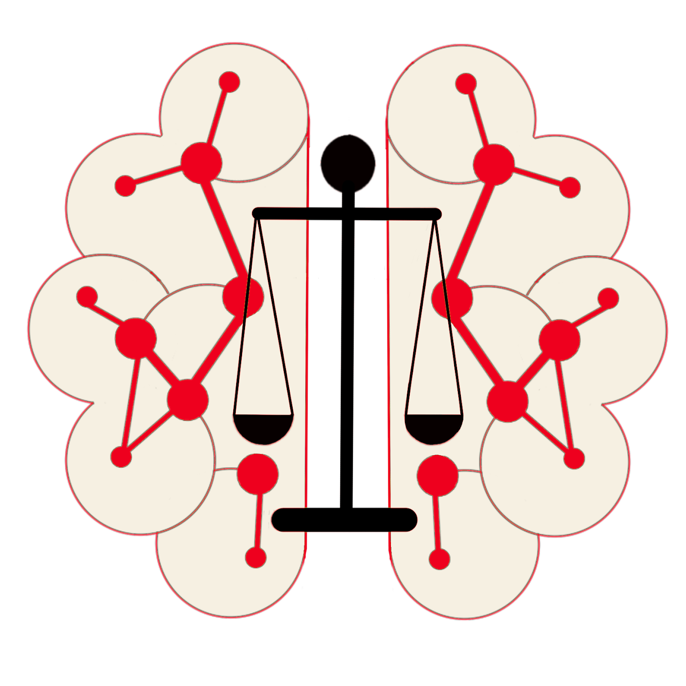
Semantic Governance
Roadmap 2024 - 2025
Metaphacts Footprint
SEMANTIC
Governance

Slide 2
Semantic Governance Improves Relevancy & Understanding for Business and Technical Stakeholders
SEMANTIC
Governance
WHAT is it?
Semantic Governance is built atop ontologies, linked data, and graphs to simplify search, discovery, and enable advanced querying, reasoning, and understanding across digital assets.
WHERE does it fit in?
Semantic Governance is enabled by a Semantic Knowledge Layer that sits atop existing infrastructure (e.g., data, systems, tools) to provide a unified, meaningful view of structured and unstructured information for services and stakeholders.

Slide 3
Business Value
SEMANTIC
Governance
WHY do companies use Semantic Governance?
Data Unification - consolidates fragmented data from systems providing 360 view
Decision Making - real time context aware insights by linking & enriching data on demand
Personalization - delivers hyper-personalized UX by dynamically linking preferences, past history, profile, behavior, and persona data
Compliance - tracks lineage, provenance, policy controls, transparency, and adherence
Search & Discovery - semantic search, supporting PoV, and relevancy
AI Learning - RAG 2.0 accuracy, relevancy, and precision
Data & Analytic Literacy - extends understanding and decision making for human & machines

Slide 4
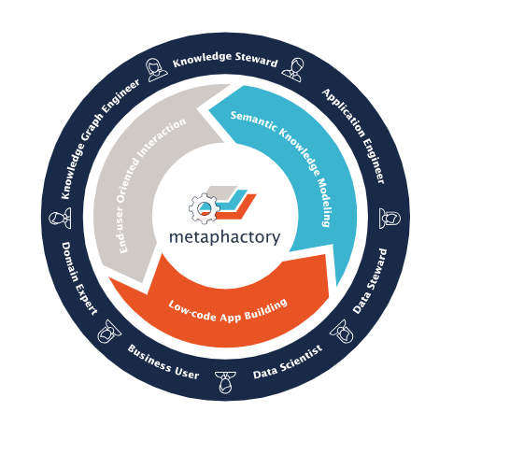
Live Demonstration
SEMANTIC
Governance
Semantic Search App
Structure
Network Wireless Vocabulary
Location Core Taxonomy
Wireless Domain Ontology
SID Ontology Linked to RAN Columns
Demo Model Mapping with Attributes

Slide 5
What Can’t We Get Anywhere Else?
SEMANTIC
Governance
Top-Down Modeling Tool
Vocabularies - SKOS compliant controlled vocabulary that is reusable by taxonomies & ontologies
Taxonomies - W3C standard structure with complex attribute management
Ontologies - Specific POV approaches to data (VZ business, SID, Core) connected using flexible but standardized relationship management
Business Integration Capabilities
Data Harmonization - Unify data from disparate source systems and generate meaning/context via business-driven taxonomies and ontologies
Collaborative Taxonomy Management - Enable stakeholders to contribute to enterprise vocabularies, powering a unified semantic model

Slide 6
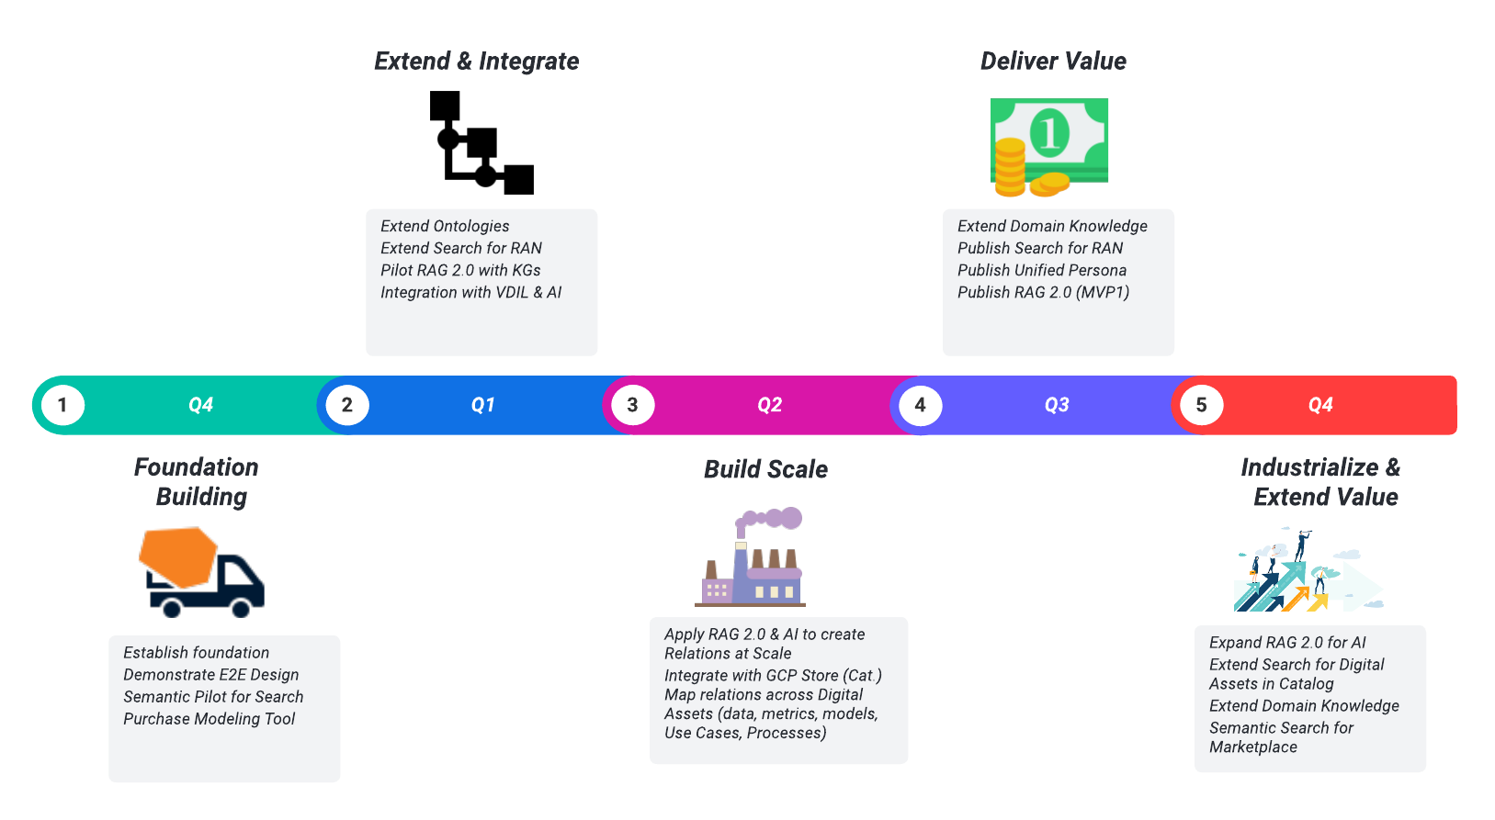
Roadmap 2024-2025
SEMANTIC
Governance
Notes:
2023 EnGRAM Prioritization & Backlog🔗
EnGRAM Review Prioritization 2023🔗
Search
Ready for production
Retire champion / challenger
Model reuse for Enhanced
Auto retiring
How do we do 90% of retirements
EnGRAM is not a model registry
MLFlow is close to a model registry
Key is tieng this into AIMLOps
Staffing Model
Mayan K. onshore
2 dev offshore
Front end
Back end
Operational Support
20% x 2 FTEs
2.8 FTEs for Projects
EnGRAM mapping to AIMLOps
UX Design Q3
API Design
Need to load Integration enhancements with AIMLOps into Gitlab
Get artifacts for define / design into issue
EA Provisional Approval
CS Provisional Approval
Bypass Flag for Sol Design Approval
Cindy Lin - under Mike Tang requested Child Line Exclusion

Slide 7
Enabling the Knowledge Fabric
SEMANTIC
Governance
Data Fabric
Focus on infrastructure enabling integration, access, and orchestration of data across diverse systems, formats, and locations in a unified, scalable way.
Ensure that data is accessible, governed, and available to support operational and analytical use cases.
Typically includes ETL/ELT tools, data lakes, data warehouses, APIs, and governance frameworks
Knowledge Fabric
Focus on context, meaning, and intelligence from integrated data.
Extends the data fabric emphasizing the semantic layer by dynamically enriching data with context, relationships, and meaning using ontologies, knowledge graphs, and AI-driven reasoning.
Derives insights, enhances decision-making, and creates a shared understanding across an organization by connecting and contextualizing data.
Complimentary

Slide 8
Appendix: Demo Reference Slides

Slide 9
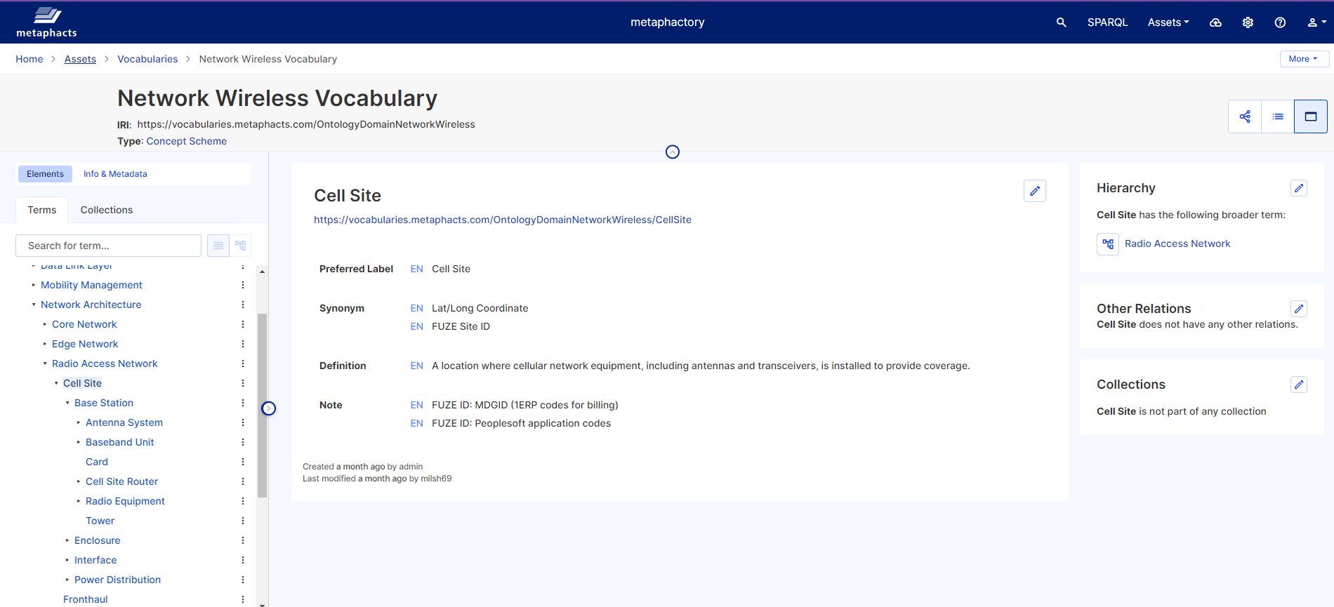
Vocabulary Sample
SEMANTIC
Governance

Slide 10
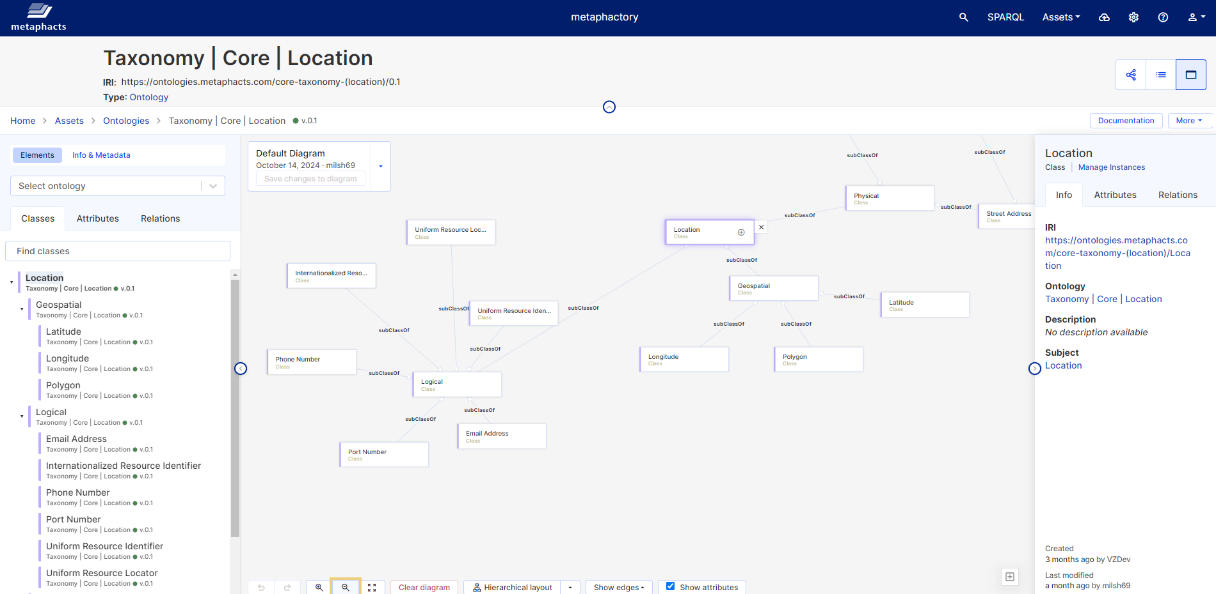
Taxonomy Sample
SEMANTIC
Governance

Slide 11
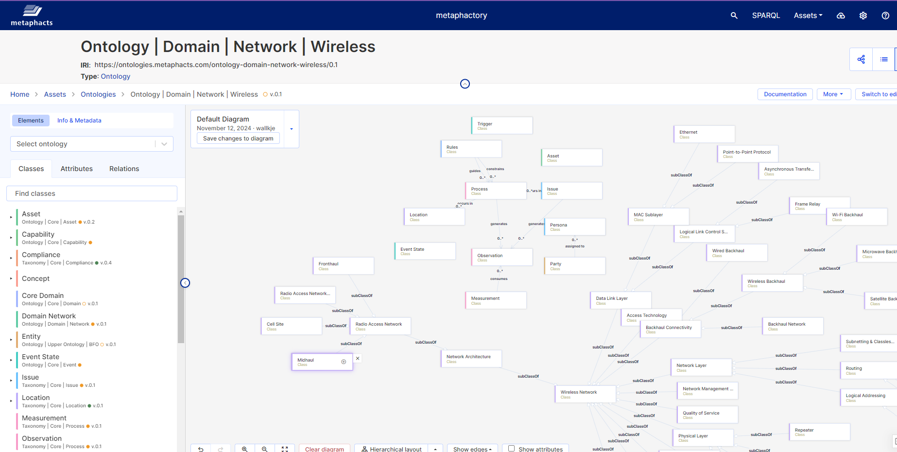
Domain Ontology Sample
SEMANTIC
Governance

Slide 12
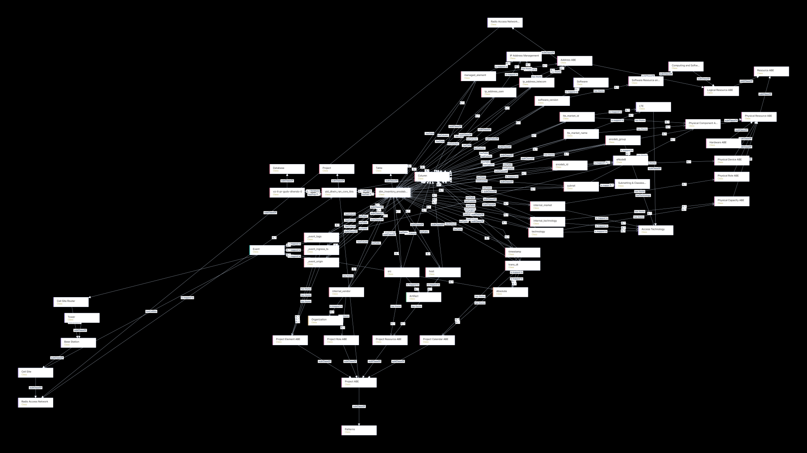
SID Ontology linked to dim_inventory_enodeb_norm_v0_anonymized
SEMANTIC
Governance

Slide 13
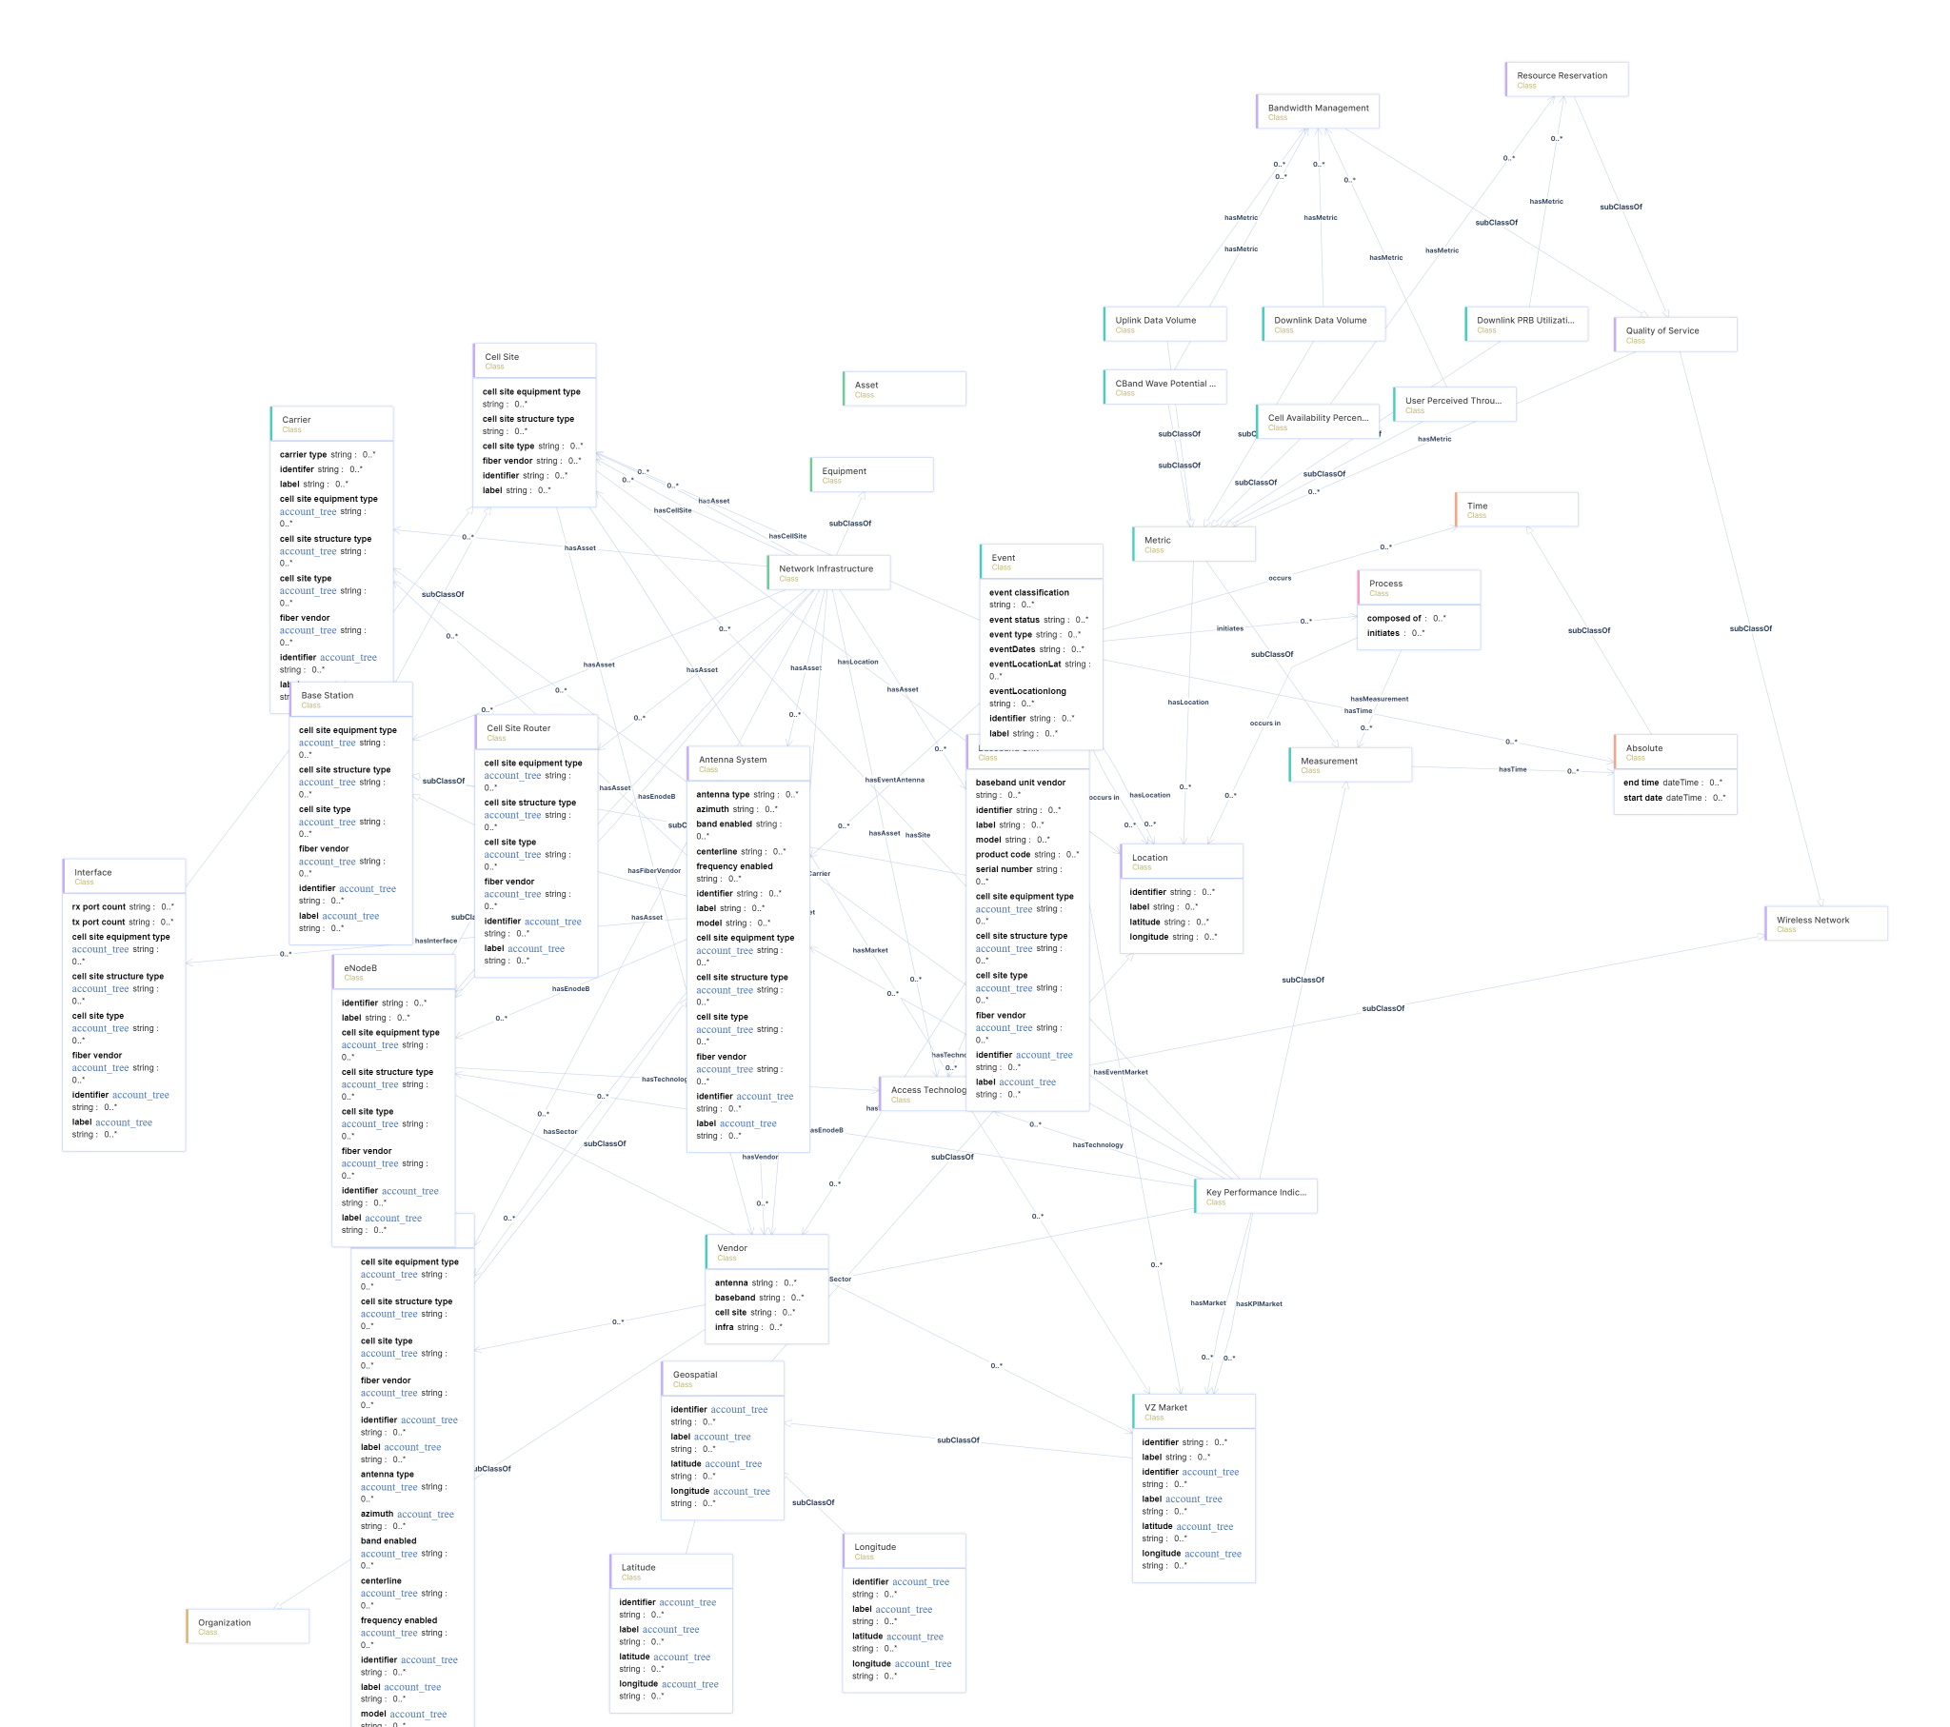
Demo Model Mapping with Attributes
SEMANTIC
Governance

Slide 14
Appendix: Overview

Slide 15
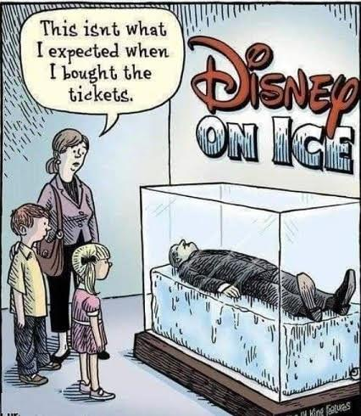
Context Matters!
SEMANTIC
Governance

Slide 16
What
What is Semantic Governance?
SEMANTIC
Governance
WHAT:
Semantic Governance helps users access data using familiar terms (not necessarily those in the glossary of terms in a catalog or perhaps an enterprise dictionary). Semantics are associated with a point of view (POV) for a persona and/or a point in context (scenario). But, it's more than just simple mapping of terms. It extends to phrases that can be interpreted and mapped to complex data. The semantic layer provides contextual relevance for our analytics so we can harmonize points of view into a holistic and consistent understanding.
HOW:
In order to achieve a consistent meaning of content it must be informed by context that is relevant (mapped to terms that are familiar to Personas) across the organization. Requires a disciplined effort to curate both the semantics and their mappings to our structured vocabularies and ontologies.

Slide 17
Why
Why invest in a Semantic Governance?
SEMANTIC
Governance
What can it do for me?
Aggregates, integrates, and organizes data and information to create a unified view, making it easily accessible for decision-makers by providing relevant insights and context at the right time.
Provides a structured way to represent information to model relationships, context, and hierarchies to enhance learning, curate context, and connect structured and unstructured data to help AI understand and interpret data and information to deliver meaningful insights.
Supports continuous learning for AI so it can adapt as new data, context, and information become available and improves insight delivery by enhancing transparency and explainability.

Slide 18
How
How will Semantic Governance help VZ?
SEMANTIC
Governance
Key Outcomes:
Consistent | Connected | Clear understanding about what changed, why things changed, and who might be impacted. Ensure our Data is FAIR (next slide) and Consumable (search & understand).
We could leverage the semantic layer to reduce ambiguity with different reports about the same topic (for example: Customer Churn could generate multiple reports showing various perspectives, where each is correct but only result in confusion until they are contextually harmonized so we can clarify meaning across a complex set of factors. )
Goal:
Deliver adaptable services, processes, systems, analytics, UX, and CX and accelerate decision making across the organization.

Slide 19
Wow
FAIR-ification of Data
SEMANTIC
Governance
Findable
(Meta)data based on W3C Semantic standards
Persistent identifiers (URIs / IRIs)
RDF-based metadata
Interoperable
OWL-based ontologies
References and links to existing data sources
Accessible
HTTP-resolvable URIs
SPARQL Endpoint
Linked Data Platform API
Re-usable
Use of established vocabularies for metadata
Management of data provenance (voID)

Slide 20
Semantic Governance:Target Outcomes
SEMANTIC
Governance
Trusted BI & AI
Smarter, More Reliable AI & Analytics
Business Literacy
A Single Source of Truth for Business Language
Meaning at Scale
Future-Proof, Standards-Based Knowledge
Improved Decision Making
More Informed Decisions, Faster
Knowledge Preservation
Living Business Knowledge That Evolves With Us
Align Business with Technology
One Semantic Layer Connecting People and Systems

Slide 21
Semantic Governance: Positioning
SEMANTIC
Governance
Type | What It Governs | Main Focus | SG’s Unique Impact
Data Governance | Quality & access of raw data | Data reliability, privacy, compliance | Ensures raw data is ready for modeling
Metrics Governance | KPIs & metric definitions | How metrics are calculated and displayed | Makes metrics universally meaningful
Analytic Governance | Analytics tools, dashboards | Valid insights, trusted analytics | Guarantees context and consistency
AI Governance | Models, AI outputs | Ethical, explainable AI, bias prevention | Feeds AI robust business meaning
Infrastructure | Pipelines, systems | Scalability, performance, uptime | Semantic layer abstracts complexity
Semantic Governance | Metadata, relationships | Context, definitions, traceability | Provides unified, actionable business logic—making all other governance efforts “intelligible” and interconnected

Slide 22
Appendix: Purchasing

Slide 23
Metaphacts Footprint (Justification)
SEMANTIC
Governance
Need sufficient compute to
Build Top-Down Ontologies covering VZ knowledge (linear and finite)
Build Bottom-Up Ontologies using ingested data structures for digital assets (high volume will grow over time)
  (RI + subset of attributes) from the Catalog (30,000 and counting)
Build Mapping Ontologies (relationships) between Top-Down and Bottom-Up (this will grow exponentially)
Generating multiple views (diagrams) covering the above models adds an entirely new load of compute
Current State
We are already experiencing performance issues and we have a small number of assets (data structures) that we have loaded and mapped.
We are not able to load diagrams for some of our models (and these are not large ones)
We minimally need the 64GB RAM and 500TB of space so we can turn on the ingestion pipeline and begin mapping at scale (once we have configured the integration with VZ Gemini).

Slide 24
Metaphacts Footprint
SEMANTIC
Governance
Hardware Estimates:
Dev:
Compute: (Cores) [ 4 Cores ]
Memory: (GB) [ 16GB min ]
Storage: (Graph DB) [ 1TB - Multiple Pilots ]
Prod:
Compute: (Cores) [ 8 Cores ]
Memory: (GB) [ 32GB min]
Storage: (Graph DB) [ 1TB - Multiple KGs ]
Demand is based on Roadmap Estimates
Need to get the platform cost estimates + Cap Labor + support
rolled into one big ask from David

Slide 25
Ontotext GraphDB Purchase
SEMANTIC
Governance
Assume Support for GraphDB is included in our Metaphacts Support costs
RDF Store Estimates:
Variable due to the Core size (assume a 12-core machine):
1 year Production license: $34,800
1 year Development License: $17,400
Action Required:
Need to find out if VZ has a EULA with Ontotext. IF so, we may be able to piggyback off that agreement with our GraphDB purchase (perhaps even achieving favorable discounting)

Slide 26
Metaphacts Purchase
SEMANTIC
Governance
Get the official quote from Russell to Bob
Get the SR Created this week
Location: On Prem
License Type:
Subscription, support included into license cost.
80% Capex / 20% Opex Accounting Rule applies
Production licenses: $101k per year
Non-Prod licenses: $50,500 per year -- same functionality as Production license
Year 1: (12 months non-prod then 6 months prod) = $101,000
Year 2: $151,500 (2 instances: 1 Non-prod / 1 prod)
Year 3: $151,500 (2 instances: 1 Non-prod / 1 prod)
Total: $378,750 ($303,000 CapEx*) + ($75,750 OpEx)
80% Capex / 20% Opex Accounting Rule due to support included in license cost
Professional Services: 50 days T&M, invoiced monthly
*Is this discounted from the total $405k for 3 years of licensing?
Total costs for 3yrs would run $630k

Slide 27
Business Continuity (SG)
SEMANTIC
Governance
Semantic Knowledge Layer
Backup Scripts:
Manual - After Each Update / Release for Metaphactory
Automated - Daily & Weekly extract from GraphDB
Automated - Monthly (Postgres) (TBD)
Standard Infrastructure Principles:
Run current version (-1)
Vendor Documentation (online)
Utilization for Storage should not exceed 33% (?)
Monitoring & Measurement:
Security
Technical / Operational Availability
Capacity
  Storage (GraphDB)
  Application (Metaphactory)
Integrations
  SSO Agent
  LDAP
  VDIL - Services
    Inbound
    Processing
    Outbound
(Kubernetes)
(Kubernetes)
Metaphactory
v5.x
GraphDB
V10.x
Postgres
GraphDB Export/Import
Metaphacts Backup
(As Needed)
GraphDB Backup
(Daily)
Postgres Backup
(Monthly)
GraphDB Backup
(Weekly)

Slide 28
Value Points:
Build it once...use it many times
Standard naming
Enhanced Search
Simplified Asset Mapping
Improved Relevancy
SEMANTIC
Governance
Marketplace Search Use Case
Quick Wins
  Reduces manual effort across D&AG teams
    Enabled by designating a “same place” to start search improvements for disparate resources
  Transition Metamodel to Metaphacts
    Enabled by transformation to follow SKOS the default format for vocabularies in Metaphacts
Pilot Project
  Promoting One Verizon meaning at scale while preserving individual perspectives & concerns
  Augment Search & Retrieval using a more intuitive experience
    Enabled by leveraging core concepts in taxonomies to provide consistent terms & in ontologies to provide consistent structures
Long Term Impacts
  Map Persona needs to relevant search content based on their desired outcomes
    Enabled by building a Unified Persona Model
  Drive AI Initiatives with minimal hallucinations
    Enabled by partnerships with cross-functional teams

Slide 29
Semantic Pilots:
Generative Hierarchies:
Success Criteria:
Auto generate one hierarchy (section) using:
Context
  Instance Metadata (??)
  Vocabulary
Hierarchy Terms
  Polymorphic Terms
  Polymorphic Meaning
  Generated Descriptions (GenAI?)
Rules
  Context Driven Rules
  Minimize Hardwiring
Semantic Search:
Success Criteria:
Augmented search for Data Product (RAN):
Multiple Points of View / Traversal:
  Metamodel
    Data Domains
    Subject Areas
  SID
  Business Domains (Ont)
  Business Concepts (Voc)
    Terms
    Synonyms (POV)
Intelligent Assistant
  Suggestions based on context
Personalization (bonus) [ see notes ]
SEMANTIC
Governance
Notes:
Personalization showcases the power of the Semantic Models:
Security: Dynamic Provisioning
Beyond ACL / ADOM Groups
Multi-faceted Rules
Experience: Dynamic Tailoring
Unified Persona Model
build out 1-2 of these

Slide 30
Appendix: Implementation

Slide 31
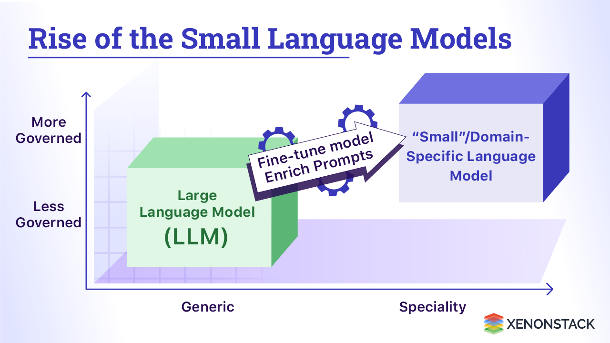

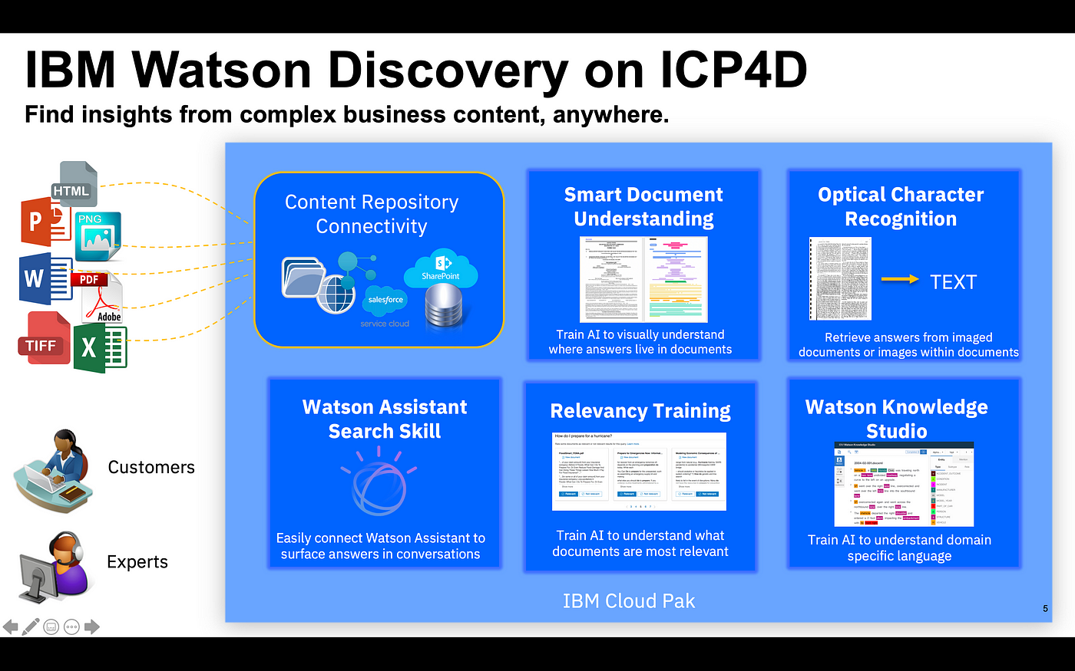
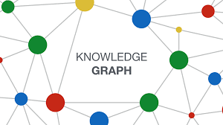
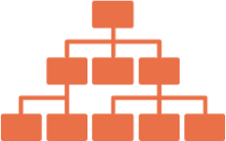
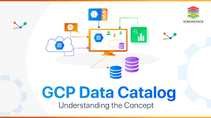


Federated Knowledge (Build Once Used Many Times)
SEMANTIC
Governance
Ontology
Formal definition of your
schema which can be extended at any time
Unified General (LMs) & Domain-Specific Knowledge (KGs)
(structured & accurate)
Standard Terms & Taxonomies for Data, Data Products, Metrics, and AI Models
(consistent & aligned)
Vocabularies Comprehensive categorization and classification of data
Augmented SEARCH (intuitive & relevant)
Rules & Constraints
Data quality assurance and support for automated reasoning
Dimensions
(Standard + Custom Hierarchies)

Slide 32
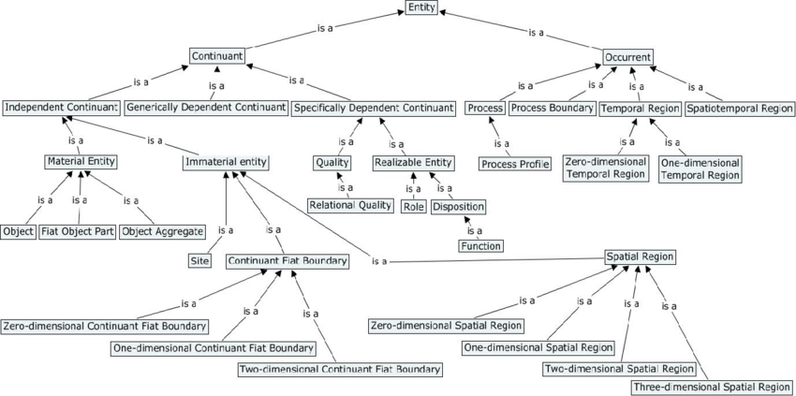
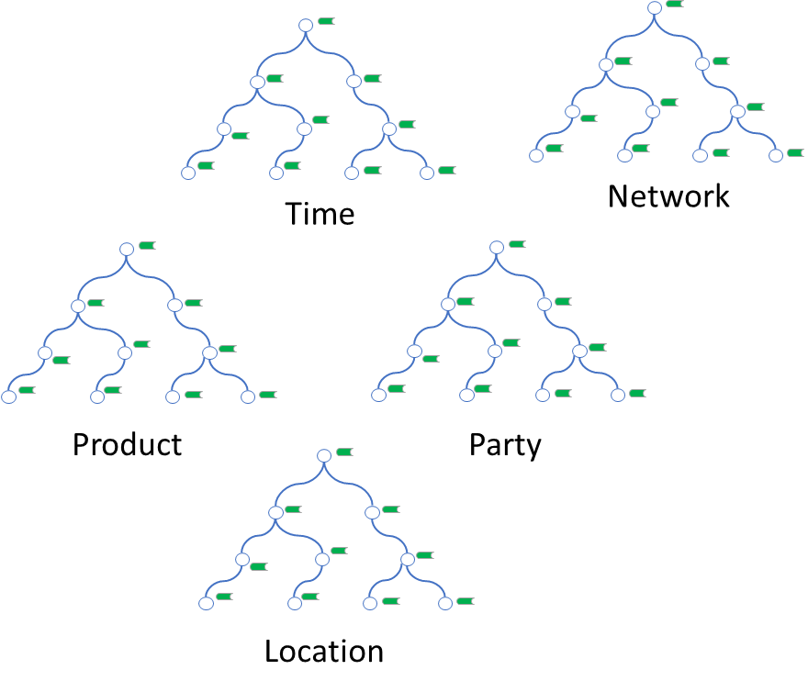
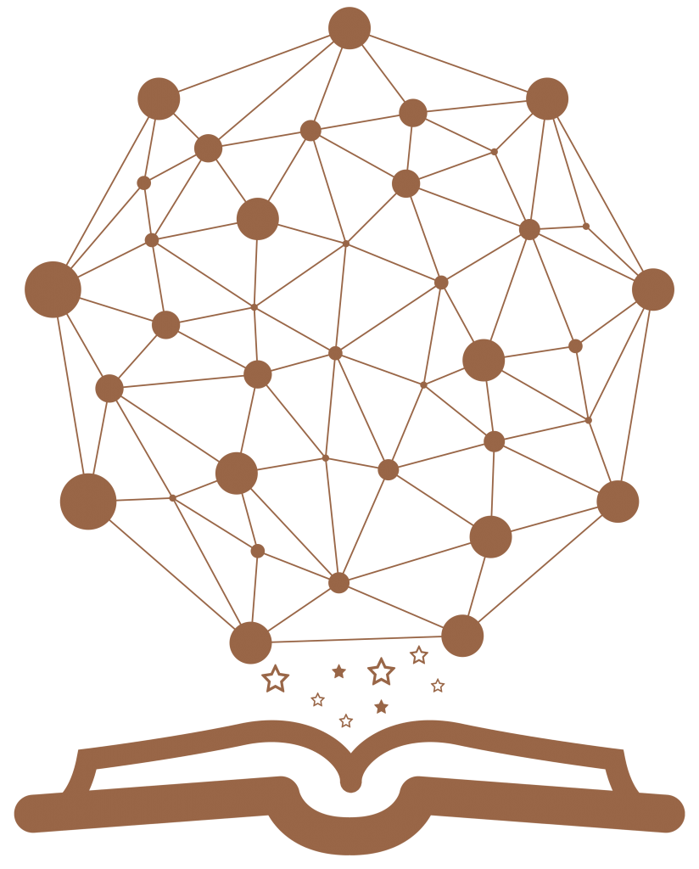
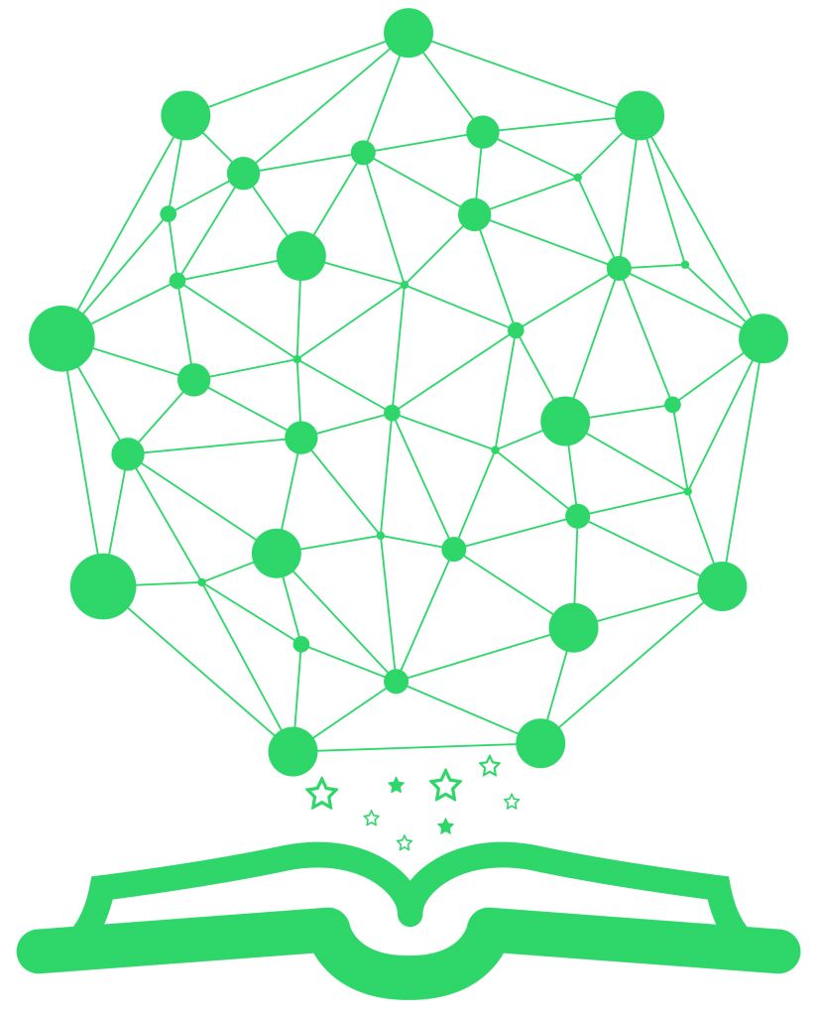
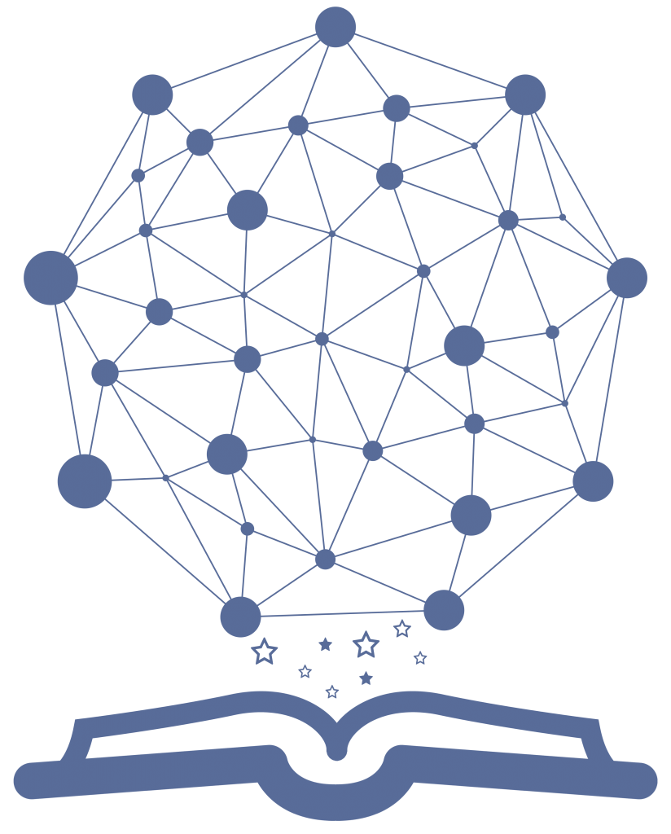
How
Semantic Governance 3-Tier Architecture
SEMANTIC
Governance
Semantic
Knowledge
Upper Ontology
Business Knowledge
Taxonomies
Network Operations
Finance
Ontologies
(Domain Specific)
Customer Support
R2R Mapping M:M
RDF Store
Persistent
(Triples for DDL)
Metadata
Metadata
Structures
Mapping
1VZ Data
(Metadata + Instances)
DDL 2 Data Mapping 1:1
RDF Store
Transient
(Triple for DDL + Data)
Content
(Instances)
Instances

Slide 33
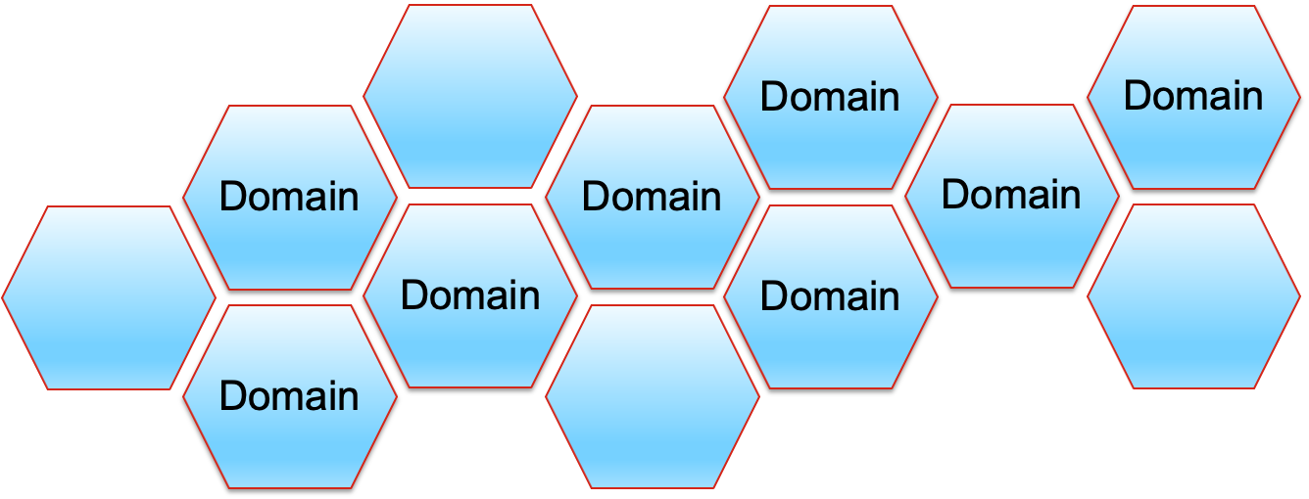

How
Semantic Pilot (Solution Architecture)
SEMANTIC
Governance
Intuitive
Consumable
Relevant
UPM
1. Designing
NLQ
Ontology Level Mapping
Onto Classes 2 RDB Classes
Top Down 2 Bottom Up
Focus
Filtering
Relevancy
2. Learning
SPARQL & SHAQL
RDF Store
Persistent
(Triple for DDL)
SQL
SQL
SQL
3. Loading
DDLs
DVCF
Protection
Auto Generate R2RML Script
Mapping RDB Class IRIs to RDB SchemaX + Data IRIs
GCP BQ
RDF Store
Transient
(Triple for DDL + Data)
4. Staging
Result Sets

Slide 34
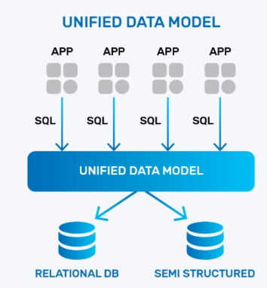


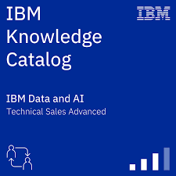
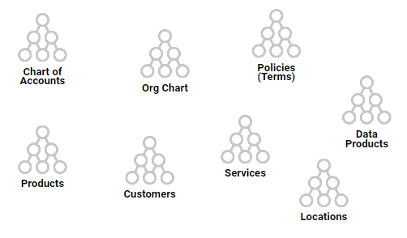

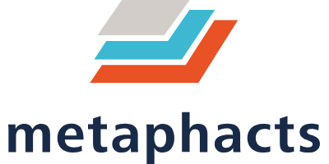
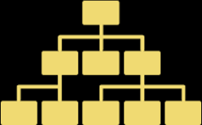


WHERE
Positioning the SKL & Semantic Metrics Hub
Semantic Metrics Hub
(Dimensions, Unified Data Models, Calc Execution)
SEMANTIC
Governance
Provisioning
Unified Data Models (built with Semantic Abstraction)
Protection
Calc
Execution
Performance
Version Management
Data Assets
Data Products
Metrics
Personas
Processes
Dimensions
AI
Models
Use Cases
Views
Logic
Standard & Custom Hierarchies
Core Taxonomies
Domain Knowledge
Semantic Knowledge Layer (SKL)
Standard Vocabulary
Harmonized Rules
Domain-Specific Ontologies

Slide 35
Semantic Governance Integration Topology
CSG
SEMANTIC
Governance
VCG
Services (Pub):
Search (SKL Only):
Token-Based
Boolean
Semantic
Personalized
Finance
VBG
Services (Pub):
Knowledge Curation:
Domain-Specific Graphs
X-Domain Graphs
Mapping (intra Domain)
Mapping (inter Domain)
Semantic Knowledge Layer
(SKL)
Consumers
Human + Machine
AI&D
Services (Pub):
Search (SKL + AI):
Augmented
Interactive (NLP)
Recommendation
EA
CISO
NTS
HR
Ingestion (Sub):
Asset Repositories
Data (GCP)
Docs (Google)
Catalogs (VDC + …)
Metrics + Dimensions (Alation)
Persona (HR, CISO, UX Profiles)
Other Digital Assets across VZ…
Learning (Sub):
AI Language Models
Domain Specific (SLMs)
Enterprise (LLMs)
Vendor Platforms (incl. LLMs)
Solutions (VZ specific)

Slide 36
Cloud Spanner Topology & Flow
SEMANTIC
Governance
Semantic Governance (RDF Layer)
Metaphactory + GraphDB
Vocabularies, Taxonomies, Ontologies
Schema Ingestion
Taxonomy & Vocabulary Publishing
Top-Down Ontology Mapping to Bottom-Up Structures
Source Systems
Apps
Data
BigQ
Teradata
Others…
Cloud Spanner
(central data hub)
Row-based OLTP
Columnar OLAP
Analytics & Reporting
LookML
Looker
1VZ Data (ETL)
Data Ingestion
RT Analytics
& Deep Insights
Top-Down Mapping to Bottom-Up Structures + Data Instances
Graph Analytics (LGP Layer)
Neo4j

Slide 37
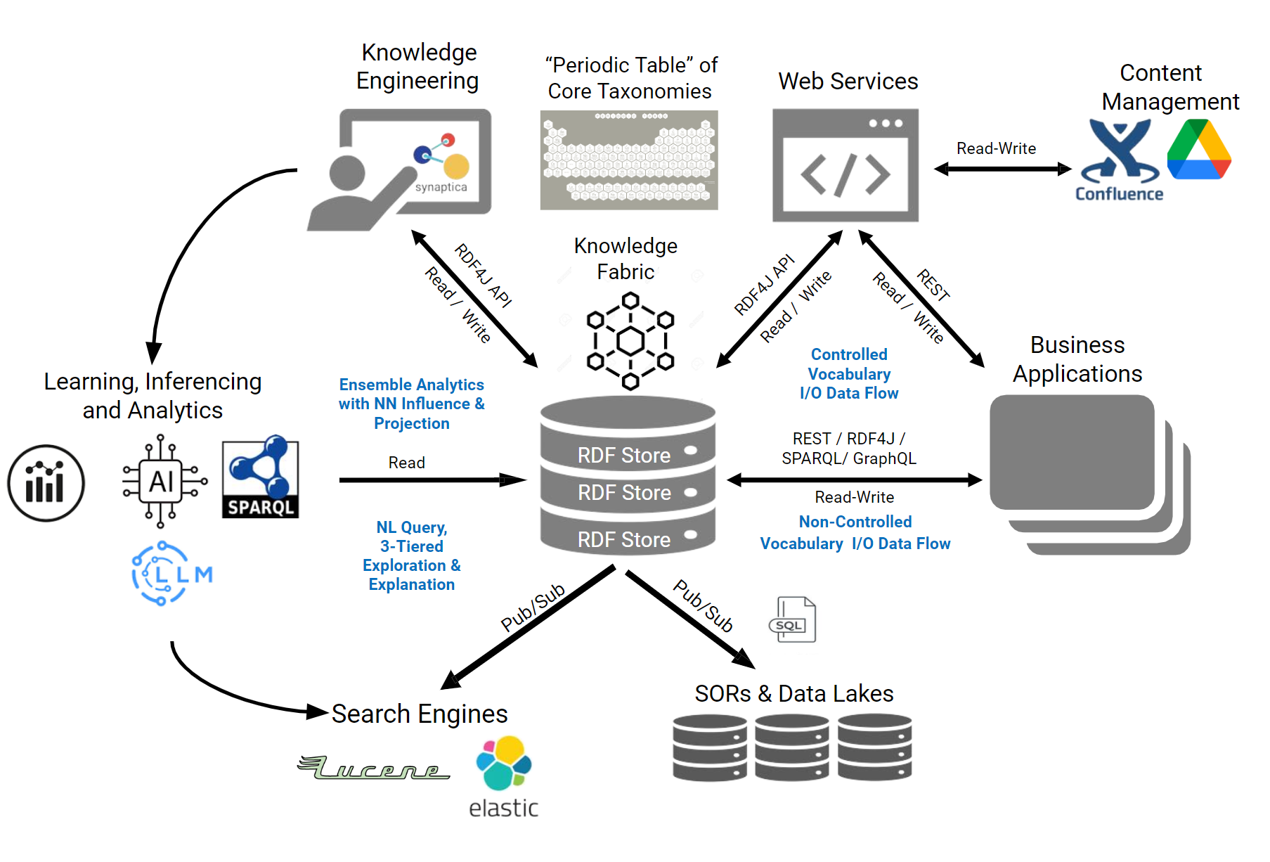
Target State: Positioning the Semantic Knowledge Layer
SEMANTIC
Governance
Core Taxonomies form the DNA
of our Knowledge Fabric
♦
Federated Knowledge Graphs (Business Domains) delivers “Meaning at Scale”
♦
Federated RDF Stores delivers linear performance for search, discovery, unified analytics, and learning
Evolutionary Approach

Slide 38
Emergent Intelligence via Agents
Agent: Reference Model
SEMANTIC
Governance
Goals
Convergence of 4 separate disciplines:
BI (analytic)
AI (probabilistic)
SI (deterministic)
DI (decisions)
Memory
Agent
Sense*
& Understand
Reason
Plan
Decide
LLM
SLM
Learn*
SLM
SLM
Coordinate
Act

Slide 39

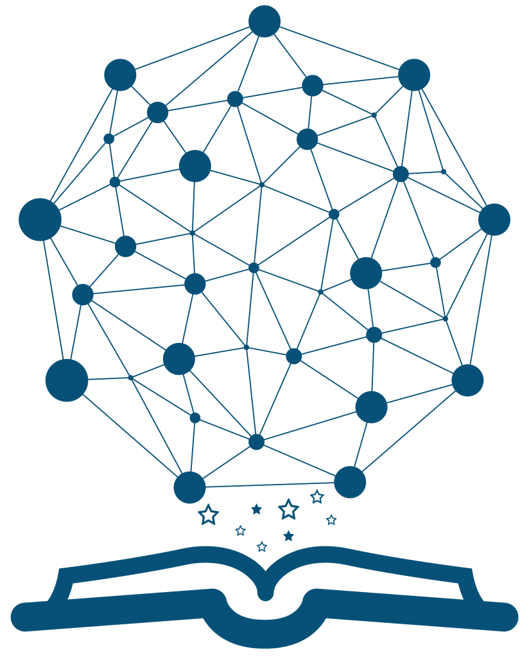


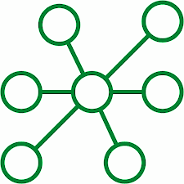


Conceptual overview of Agent-Based Insights & Governance
Taxonomy & Ontology Publishing
SEMANTIC
Governance
Domain Specific Ontologies
Domain Specific KGs
(Knowledge Fabric)
Data Lineage
Agents
Data Observability
Agents
Auditing & Instrumentation
Agents
Change Data Capture
Agents
Profiling
Agent
Enrichment
Agent
`
Visualization
Agents
Classification
Agent
Consumers
(human & machine)
Identity & Access
Agents
Data Sources
Integration
Agents
Data & Component Assembly
Agents
Semantic Harmonization
Agents
Federated Search
Agent(s)
Data Sources
Data Sources
Data Protection Agents
Analytic Agents
Agents
Explanatory
Agents
Transformation
Agents
Quality Profiling
Agents
Data Mastering
Agents

Slide 40
Integrating AI + LLMs with Knowledge Graphs
SEMANTIC
Governance
The semantic layer maps all digital assets to more easily identify, search, assemble, provision, and protect them. It also provides a progressive roadmap for analysis, queries, and delivering self-service analytics and explanatory responses to complex questions agnostic of any interface (Executive Interface, Conversational Interface - Slack, and Analytic Interface via one or more BI Tools).
The semantic layer can detect conflicts in definitions, duplicate meanings, across systems and trigger alerts for consumers and even suggest remedies.
The semantic layer is the “expert in the middle” that understands the query and the data who can resolve ambiguity and can promote the consumer for clarification. Implementing generative AI tools and LLM is problematic and can lead to spurious results without a semantic layer to address ambiguity and provide consistent meaning at scale.
Soon, we will be able to introduce retrieval augmented generation (RAG) using Knowledge Graphs to support LLMs to improve accuracy. The semantic layer provides a highly accurate foundation for curating and training our Custom LLMs and SLMs (smaller, domain-specific) and significantly reduce the likelihood of hallucinations.

Slide 41
Semantic Layer Role in the Ecosystem
Semantic Layer
Discover, Search, Unified Context
Unified Grounding (Causality)
SEMANTIC
Governance
Search & Exploration
Profiling & Enrichment
(includes Classification)
Causality & Impact
Discovery
(meaning)
AI + LLM
Virtual Catalog
(RDF Store)
Unified Context
Analytics
Staged
Analytics & Aggregates
Integration Services
Custom Models
Semantic Discovery
Metrics
Workflow
1VZ Data
MicroServices
Reasoning
On Demand Insights
Precise Extraction
Data Transforms
(DBTs)
Provisioning
AI
Protection
Correlation
Explanation
SOR
SOR
SOR

Slide 42
Integrating Graphs & AI LLMs into the Semantic Knowledge Layer
Semantic Layer
Discover, Search, Unified Context
Unified Grounding (Causality)
SEMANTIC
Governance
Domain Graphs
(Finance)
Domain Graphs
(Sales)
Domain Graphs
(Network)
Domain Graphs
(Legal)
Domain Graphs
(Marketing)
Domain Graphs
(Global Tech)
Domain Graphs
(HR)
Domain Graphs
(Wireless)
Domain Graphs
(Wireline)
Intelligent Agent
Search & Exploration
Profiling & Enrichment
(includes Classification)
AI Models
AI LLM
(Finance)
AI LLM
(Sales)
AI LLMs
(Network Ops)
Intelligent Agent
AI LLM
(Legal)
AI LLM
(Marketing)
AI LLM
(Global Tech)
AI LLM
(HR)
AI LLM
Wireless Services
AI LLM
Wireline Services
AI + LLM
Causality & Impact
Semantic Publishing
Intelligent Agent
Discovery
(meaning)
Intelligent Agent
Intelligent Agents
Intelligent Agent
Virtual Catalog
(RDF Store)
Unified Context
Analytics
Staged
Analytics & Aggregates
Integration Services
Intelligent Agent
Metrics
Semantic Discovery
Workflow
Intelligent Agent
MicroServices
Reasoning
1VZ Data
On Demand Insights
Precise Extraction
Data Transforms
(DBTs)
Intelligent Agent
Intelligent Agent
Provisioning
AI
Protection
Intelligent Agent
Correlation
Intelligent Agents
Explanation
SOR
SOR
SOR
The Design for the Semantic Layer follows a component model built using Domain Driven Design (DDD Principles) to enable Federation of Intelligent Agents delivering services orchestrated using an Event Driven Architecture

Slide 43
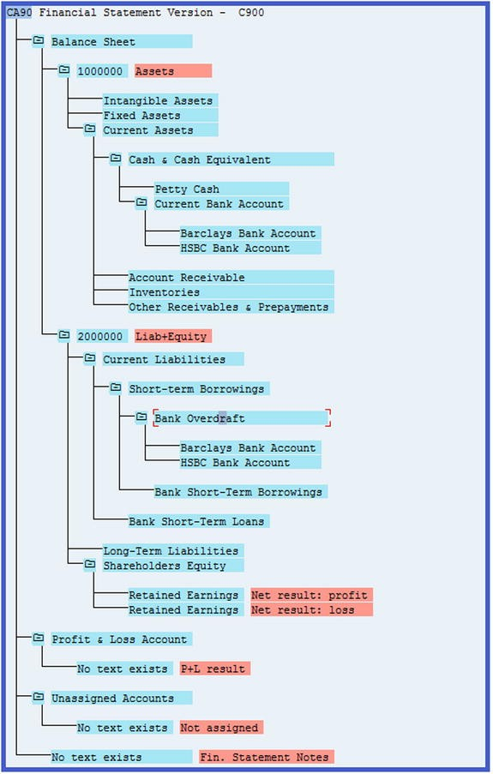
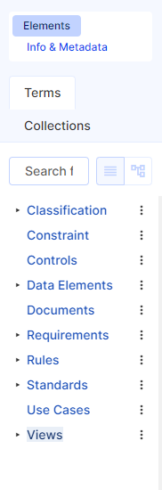
Semantic Pilot - Build & Deploy Standard Reporting Hierarchy
SEMANTIC
Governance
Building standard reporting hierarchies using core taxonomies and domain-specific ontologies:
5-Step Approach
1. Establish a structured vocabulary
2. Create a classification system of core taxonomies (enterprise building blocks)
3. Define domain specific ontologies supporting the main categories and subcategories of your data
4. Conduct discovery with domain SMEs and Add deeper relationships and context between classes in a composite ontology (representing the hierarchy)
5. Introduce more complex connections to enable more nuanced analysis and reporting for the data
Dimensions
(Standard + Custom)
Extend & Curate Vocabulary
Curate Taxonomies & Ontologies
Build and Publish Standard Hierarchy(s)

Slide 44
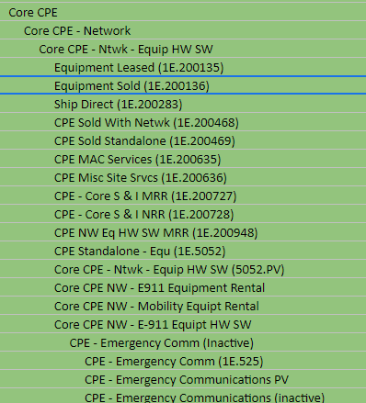
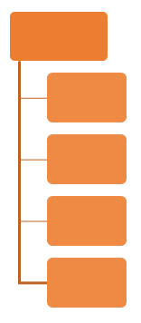
Component Design for Modeling Business Knowledge at Scale
SEMANTIC
Governance
Ontology
Taxonomy
Ontology
Vocabulary
Taxonomy
Ontology
Taxonomy
Ontology

Slide 45

SKL & Semantic Metrics Layer
AI + LLMs
Gen AI
SEMANTIC
Governance
Core Taxonomies
(Standard Vocabulary)
Explain
Recommend
Intelligent Query
Semantic Knowledge
Personalization
Causality + Impact
Dynamic & Temporal
Analysis
Dimensions
(Standard + Custom)
Adaptable & Intelligent UX
Metrics Library
Metrics Engine
(Headless BI)
Persona
Intelligence
Provisioning
Protection
Semantic Metrics Hub
Staged
Calcs
LookML
(Dimensions, Unified Data Models, Calc Execution)
“Single Pane”
Staged
Aggregates
Staged
Data
Data Access Layer
Data Protection
OLAP
OLTP
Views
Objects
OLAP
OLTP
Views
Objects
Vocabulary
Taxonomy
Ontology
OLAP
OLTP
Views
Objects
OLAP
OLTP
Views
Objects

Slide 46

DQ + MDM +Data Integrity(DI) + Semantic Quality (SQ) = Trust
SEMANTIC
Governance
Unified Persona Model
Relevancy
Semantic
Quality
Terms
Naming Conventions
Master Data Management
Taxonomies
Data Integrity
Data Products
Time_ID
Day
Week
Month
Year
Product_ID
Description
Category
Brand
Color
Data Security
Data Lineage
Data
Auditability
Terms
Naming Conventions
Taxonomies
Data Observability
Metrics & Reports
Location_ID
Street_Name
City
State
Zip
Customer_ID
Name
Profile_ID
Preference_ID
Demographics
FACTS
Time_ID
Location_ID
Product_ID
Customer_ID
Units Sold
Price per Unit
Data Quality
AI Models
Accuracy
Timeliness
Availability
Completeness
Consistency
Data Quality

Slide 47
Semantic Governance Walkaround Deck

Slide 48
How
Semantic Governance 3-Tier Architecture
SEMANTIC
Governance
Semantic
Knowledge
Upper Ontology
Business Knowledge
Taxonomies
Network Operations
Finance
Ontologies
(Domain Specific)
Customer Support
R2R Mapping M:M
RDF Store
Persistent
(Triples for DDL)
Metadata
Metadata
Structures
Mapping
1VZ Data
(Metadata + Instances)
DDL 2 Data Mapping 1:1
RDF Store
Transient
(Triple for DDL + Data)
Content
(Instances)
Instances

Slide 49
How
Semantic Pilot (Solution Architecture)
SEMANTIC
Governance
Intuitive
Consumable
Relevant
UPM
1. Designing
NLQ
Ontology Level Mapping
Onto Classes 2 RDB Classes
Top Down 2 Bottom Up
Focus
Filtering
Relevancy
2. Learning
SPARQL & SHAQL
RDF Store
Persistent
(Triple for DDL)
SQL
SQL
SQL
3. Loading
DDLs
DVCF
Protection
Auto Generate R2RML Script
Mapping RDB Class IRIs to RDB SchemaX + Data IRIs
GCP BQ
RDF Store
Transient
(Triple for DDL + Data)
4. Staging
Result Sets

Slide 50
Conceptual View of Semantic Layer: Mapping Meaning to Digital Assets
3-Tier approach focused on leveraging existing infrastructure while extending Contextual and Persona-Based Relevance to Content
domain-specific ontologies using decomposition to build, bound, and govern component knowledge using process as the first-class citizen
building scaffolded knowledge between ontologies (vertical & lateral fabric)
Formalize governance around SI (semantic intelligence) and harmonize with AI (artificial intelligence), DI (decision intelligence), and BI (business intelligence)
This is where the somatic model needs to evolve as a design pattern
Alignment on Core problem space improve Search (using a progressive roadmap)
Search for data or objects
Search & Explore insights that are relevant
Search for Answers to Questions
Guided / Augmented Search
Intelligent Assistant
Future State will introduce Lifecycle Standards and design patterns around SI, AI, & DI
Virtual & Physical instantiation of graphs will be introduced to support scale and efficiency
Future State will involve building an evolving learning capability:
capturing Deterministic Knowledge (relational and nodal facts)
capturing Probabilistic Knowledge (vector based instantiation vs algorithmic extension)
scenario-based nuance for fine-grained understanding of causality (backward & forward chaining)
SEMANTIC
Governance
Semantic Knowledge Layer
Graphs (Published in RDF Stores)
Semantic Knowledge
Metadata
Vocabularies
Ontologies
Digital
Content
Taxonomies

Slide 51
Conceptual View of Semantic Layer: Mapping Meaning to Digital Assets
SEMANTIC
Governance
Semantic Knowledge Layer
Graphs (Published in RDF Stores)
Semantic Knowledge
Metadata
Vocabularies
Ontologies
Digital
Content
Data Assets
Taxonomies
Views
Data Products
Metrics
Personas
Dimensions
Processes
Logic
Documents
Design Artifacts
AI
Models
Requirements
Use Cases
Solutions

Slide 52
Semantic Knowledge Layer: Overview
SEMANTIC
Governance
Verizon Knowledge Models
Semantic Knowledge
(Enterprise)
Semantic Knowledge
(Domain Specific)
Semantic Knowledge
(Domain Specific)
Vocabularies
Ontologies
Vocabularies
Ontologies
Vocabularies
Ontologies
Taxonomies
Taxonomies
Taxonomies
Component Design for Building out Verizon’s Knowledge
Finance
Marketing
Semantic Knowledge
(Domain Specific)
Semantic Knowledge
(Domain Specific)
Vocabularies
Ontologies
Vocabularies
Ontologies
Taxonomies
Taxonomies
Sales Operations
Network Operations

Slide 53
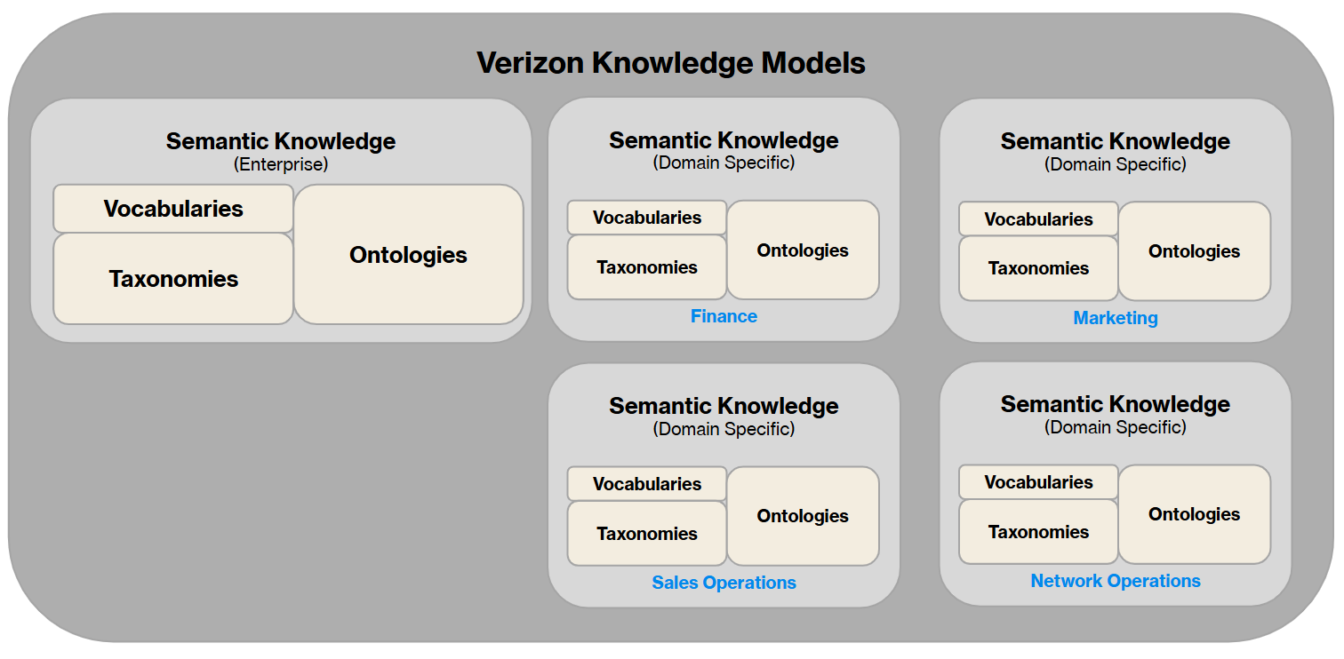
Semantic Knowledge Layer: Semantic Services (Inbound)
SEMANTIC
Governance
Semantic Knowledge Layer
Semantic Knowledge
(Digital Asset Metadata)
Ontologies
Ontologies
Meta Models
Ontologies
Ontologies
Ontologies
Ontologies
Data Assets
Views
Personas
Inbound
Services
(Ingestion Pipelines)
Data Products
Dimensions
Events
Processes
Metrics
Assets
AI
Models
Solutions
Requirements
Documents
RDF Stores
Design Artifacts
Use Cases
Metadata
Logic
Semantics

Slide 54
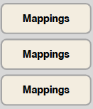
Semantic Knowledge Layer: Semantic Services (Processing)
SEMANTIC
Governance
Semantic Knowledge Layer
Semantic Knowledge
(Mapping Context to Content)
Semantic Knowledge
(Ingested Digital Asset Structures)
Ontologies
Ontologies
Ontologies
Ontologies
Ontologies
Ontologies
Intelligent Agent
Mapping Services
Analytics
Metrics
Processing Services
(Mapping Context to Content)
Ontologies
Intelligent Agents
Properties
Reasoning
Terms & Alternate Labels
Intelligent Agent
Relations
AI
Intelligent Agent
Protection
Correlation
Explanation

Slide 55
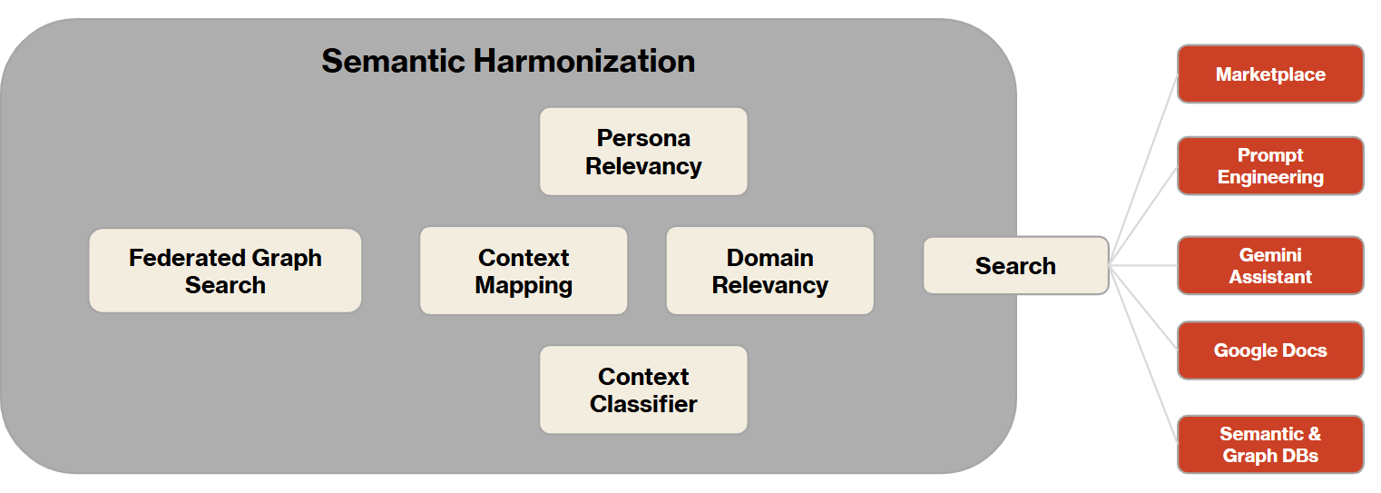
Semantic Knowledge Layer: Semantic Services (Outbound)
SEMANTIC
Governance
Semantic Knowledge Layer
Semantic Knowledge
(Mapping Context to Content)
Semantic Knowledge
(Ingested Digital Asset Structures)
Ontologies
Ontologies
Ontologies
Ontologies
Ontologies
Ontologies
Outbound
Services
(Progress Search, Dynamic Context, Augmented Intelligence)

Slide 56
SEMANTIC
Governance
Semantic Harmonization
Marketplace
Persona Relevancy
Prompt Engineering
Federated Graph Search
Context Mapping
Domain Relevancy
Search
Gemini Assistant
Google Docs
Context Classifier
Semantic & Graph DBs

Slide 57
Semantic Governance (Integration Roadmap)
SEMANTIC
Governance
Compliance Management
Knowledge Engineering
Content
Management
Semantic Governance
Metadata Management
Trad AI
Analysis & Decision Making
Analytic Insights
Knowledge Graphs
Process Management
Data
Management
Gen AI
Generate, Synthesize, Dynamic Problem Solving
Agentic AI
Autonomy, Goal-Oriented Behavior, Reasoning
Notes:
This slide outlines how Semantic Governance integrates with various enterprise functions and AI types. It acts as a central governing layer for metadata and relationships, providing context, definitions, and traceability across the organization.
Key integrations include:
Knowledge Engineering
Content Management
Process Management
Data Management (including Metadata Management and Knowledge Graphs)
Compliance Management
Analytic Insights
The roadmap also details its impact on different AI categories:
Traditional AI: Supports analysis and decision-making.
Generative AI: Enables generation, synthesis, and dynamic problem-solving.
Agentic AI: Facilitates autonomy, goal-oriented behavior, and reasoning.
Semantic Governance aims for trusted BI and AI outcomes, establishes a single source of truth for business language, improves decision-making, enables knowledge preservation, and aligns business with technology through a unified semantic layer.
Semantic Governance ensures trusted BI and AI outcomes.
It establishes a single source of truth for business language.
Semantic Governance improves decision-making with faster insights.
It enables knowledge preservation for evolving business needs.
The semantic layer connects people and systems, aligning business with technology.

Slide 58
Customer Data Harmonization (simplistic view)
SEMANTIC
Governance
CDM
(Ent)
EDM
(Ent)
Customer Data Mastering
Technical SME
Master Data Cleanup (Ent)
Master Data (Ent) Reconcilement
Business SME
CDP
ADM
(App)
Customer Profile Management
Master Data Cleanup (Ent)
Address Cleanup
Is this a complete picture of the data flows?
Are there any other tools that can modify Customer Data?
If so, do they need to be brought into the Harmonization picture?
How do we orchestration reconciliation?
Do we need to reconcile RT or Batch?
How do we manage RT Moment of Truth?
Master Data (App) Reconcilement
Address Master
(Ent)
Governance SME

Slide 59
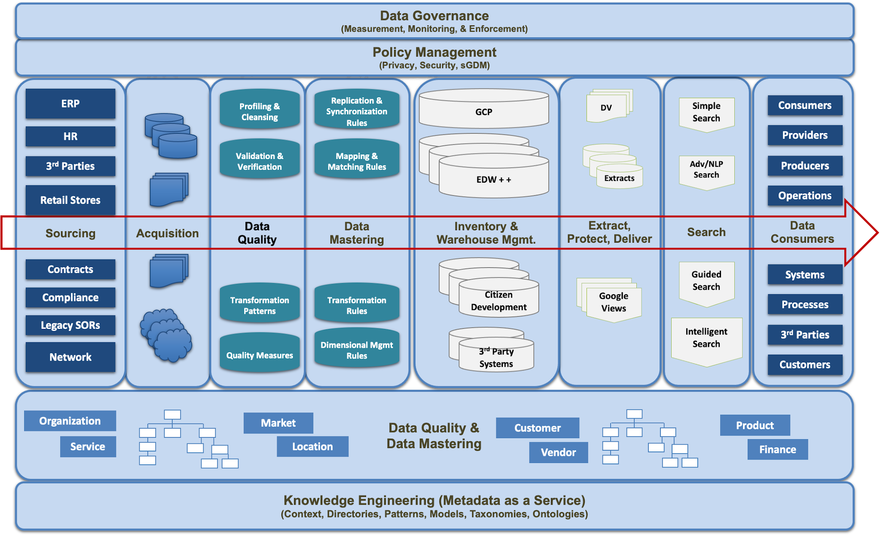
Horizontalization “Qualitative Enablement”
Existing
Emerging
SEMANTIC
Governance
Trust
Protected
Scalable
Efficient
Extendible
Quality
Unambiguous
Understandable
Fidelity of POV

Slide 60
Appendix: Planning

Slide 61
Proposed 2025 Business Priorities
Mike S - SKL
Legend
BDG Business Data Governance
1VZD Data Gov, Metrics Gov, AI Gov & BI Gov
GovAI Gov AI/GenAI advancements for Business Outcomes
SKL Gov Semantics
EDWM EDW Modernization
SEMANTIC
Governance
Feature | Business Themes (Programs) |  |  |  |  | Continue | Start What need to Stop/Slow | Year-End Outcome | KPI
 | BDG | 1VZD | GovAI | SKL | EDWM
Generate Hierarchies from Corporate Taxonomies and Vocabulary | x | x | x | x |  | Start | Generate hierarchy nodes from core taxonomies using standard vocabulary terms. | Quality, Productivity
Semantic Search & Query RAN Product | x | x |  | x |  | Continue | Business friendly search & causal inference for RAN | Speed, Productivity
Operationalize Semantic Governance | x | x | x | x |  | Start | Federated graph queries across business domains | Speed, Quality, Productivity
Augment RAG 2.0 with Knowledge Graphs | x | x | x | x |  | Start | Improve search, retrieval accuracy, relevancy, and precision for AI | Quality, Productivity
Personalization using Unified Persona Model | x | x |  | x |  | Start | Improve Relevancy & Personalization for Search and user experiences involving personas | Speed, Quality, Productivity
Semantic Mapping at Scale | x | x | x | x |  | Start | Mapping Relationships at Scale (Causality, Configuration, Dependencies, Meaning, POV) | Speed, Quality, Productivity
Semantic Search & Query Catalog | x | x | x | x |  | Start | Business-centric search using concepts instead of columns. | Speed, Productivity

Slide 62
Draft
Roadmap 2024-2025
SEMANTIC
Governance
2024 Q4
2025 Q1
2025 Q2
2025 2H
Foundation Building Installed Upper Ontology (BFO) Built Core Taxonomies Built Domain Reference Model Built Initial Set of Domain Specific Ontologies Built E2E Pilot for Semantic Search & Query Uploaded TMForum SID as RDF Mapped TMForum SID to Core Taxonomies Complete Pilots Pilot (Search RAN Product) Purchase Tool Purchase SKL tool (Metaphacts) Purchase Graph DB tool (GraphDB) Harden DEV Setup Initiate PROD instance (not in use) Extend Pilots Formalize Mapping (RDF to RDB) Build (Extend Search RAN Product) Design (Search Catalog using GCP Store) | Training & Operationalization SKL Tool Training (academy) Industrialize Mapping (SKL to RDB) Design Inferencing Capability Formalize Governance (Monitor & Publish) Setup PROD for initial launch (not in use) Build Capability & Demand Build (Hierarchy Generation) Build Demo & Setup Brown Bags (Showcase) Build (Extend Search RAN Product) Build (Search Catalog using GCP Store) Design KG & VDB for AI (RAG-Learning) Build (RAG-Learning with KG & Vector DB) Design Unified Persona Model (Relevancy) Build Integration Design 3-Tier SKL for scale (Federated Query) Define SKL Publishing / Integration Design Integration with VDIL (API) | Industrialization & Scale Formalize Intake & Measure Value Delivered Federate Domain Modeling (Bus Engagement) Enhance monitoring and measurement Formalize Application Build & Deliver Build Inferencing Capability Harden PROD & Setup Operational Team Extend Capability & Deliver Value Build Engagement and Demand Backlog Design Metamodel in SKL Explore Metamodel Transition from ERWin Publish Hierarchy Generation (MVP1) Publish Search GCP Catalog (MVP1) Publish Search RAN Product (MVP1) Publish Unified Persona Model (MVP1) Build RAG-Learning with KG & Vector DB Publish RAG-Learning with KG & VDB MVP1) Extend Integration Build 3-Tier SKL for Scale (Federated Query) Build SKL Publishing / Integration via VDIL (API) | Build Value-Driven Pipeline Manage Intake & Measure Value Delivered Build Business Engagement Expand Capacity to meet Demand Federate Domain Modeling (Bus Engagement) Industrialization & Scale Manage Engagement and Demand Backlog Enhance monitoring and measurement Improve Application Build & Deliver Extend Inferencing Capability Optimize Operations Extend Capability & Deliver Value Publish Metamodel from SKL Publish Hierarchy Generation (MVP2) Publish Search GCP Catalog (MVP2) Publish Search RAN Product (MVP2) Publish RAG-Learning with KG & VDB (MVP1) Extend Integration Extend 3-Tier SKL for Scale (Federated Query) Extend SKL Publishing / Integration via VDIL (API)
Holidays, Festivals & Moratorium, and Scheduled Time-off Nov/Dec
👉 Assumption: Additional Semantic Governance Resources (3) -> See items highlighted in RED
Notes:
2023 EnGRAM Prioritization & Backlog🔗
EnGRAM Review Prioritization 2023🔗
Search
Ready for production
Retire champion / challenger
Model reuse for Enhanced
Auto retiring
How do we do 90% of retirements
EnGRAM is not a model registry
MLFlow is close to a model registry
Key is tieng this into AIMLOps
Staffing Model
Mayan K. onshore
2 dev offshore
Front end
Back end
Operational Support
20% x 2 FTEs
2.8 FTEs for Projects
EnGRAM mapping to AIMLOps
UX Design Q3
API Design
Need to load Integration enhancements with AIMLOps into Gitlab
Get artifacts for define / design into issue
EA Provisional Approval
CS Provisional Approval
Bypass Flag for Sol Design Approval
Cindy Lin - under Mike Tang requested Child Line Exclusion

